Slide 1
Topics today
Bucket Sort
Lexicographic sort
Radix sort
(Text Book Reference 4.5)

Slide 2
Bucket sort
Is a non-comparison sort

Slide 3
Bucket-Sort
Let S be a sequence of n (key, element) items with keys in the range [0, N − 1]
Bucket-sort uses the keys as indices into an auxiliary array B of sequences (buckets)
  Phase 1: Empty sequence S by moving each item (k, o) into its bucket B[k]
  Phase 2: For i = 0, …, N − 1, move the items of bucket B[i] to the end of sequence S
Analysis:
  Phase 1 takes O(n) time
  Phase 2 takes O(n + N) time
Bucket-sort takes O(n + N) time
Algorithm bucketSort(S, N)
Input sequence S of (key, element)
items with keys in the range
[0, N − 1]
Output sequence S sorted by
increasing keys
B ← array of N empty sequences
  while ¬S.isEmpty()
  f ← S.first()
  (k, o) ← S.remove(f)
  B[k].insertLast((k, o))
  for i ← 0 to N − 1
  while ¬B[i].isEmpty()
  f ← B[i].first()
  (k, o) ← B[i].remove(f)
  S.insertLast((k, o))

Slide 4
Example
Key range [0, 9]
7, d
1, c
3, a
7, g
3, b
7, e
Phase 1
1, c
3, a
3, b
7, d
7, g
7, e
B
0
1
2
3
4
5
6
7
8
9
∅
∅
∅
∅
∅
∅
∅
Phase 2
1, c
3, a
3, b
7, d
7, g
7, e

Slide 5
Properties and Extensions
Key-type Property
  The keys are used as indices into an array and cannot be arbitrary objects
  No external comparator
Stable Sort Property
  The relative order of any two items with the same key is preserved after the execution of the algorithm

Slide 6
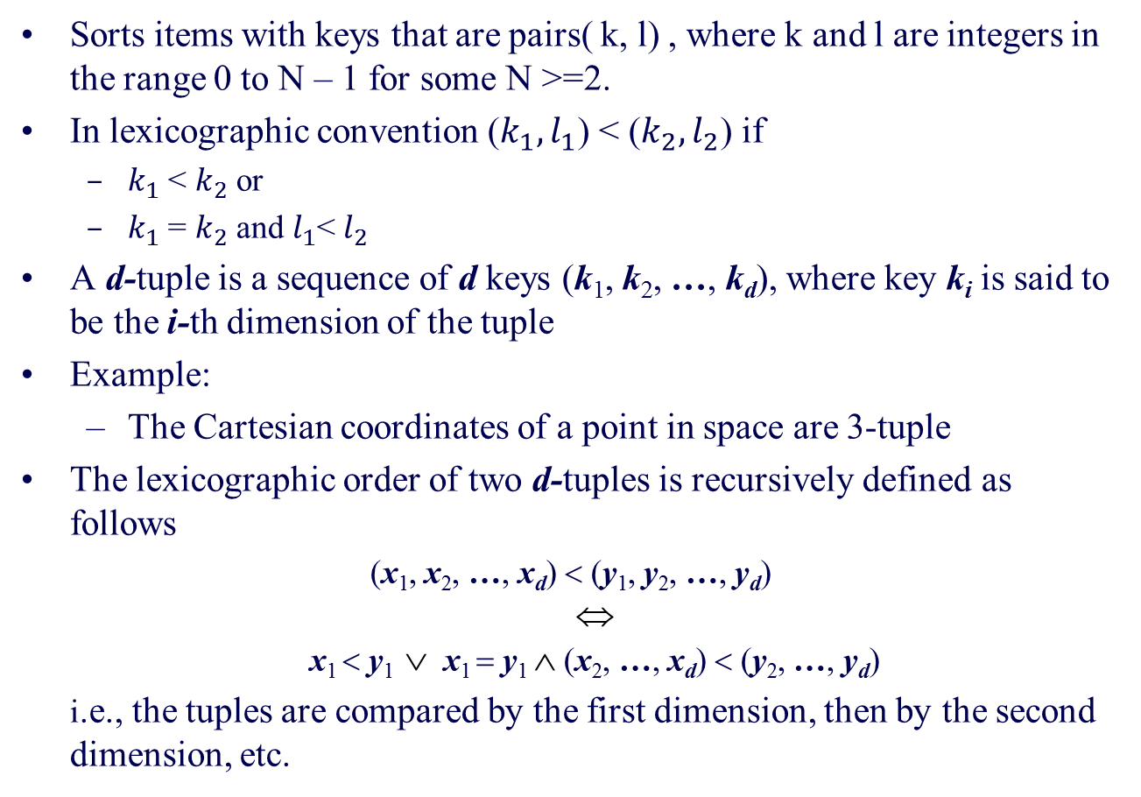
Lexicographic Order (Dictionary)
Sorts items with keys that are pairs( k, l) , where k and l are integers in the range 0 to N – 1 for some N >=2.
In lexicographic convention ($k_{1}, l_{1}$) < ($k_{2}, l_{2}$) if
  $k_{1}$ < $k_{2}$ or
  $k_{1}$ = $k_{2}$ and $l_{1}$< $l_{2}$
A d-tuple is a sequence of d keys (k₁, k₂, …, k_{d}), where key k_{i} is said to be the i-th dimension of the tuple
Example:
  The Cartesian coordinates of a point in space are 3-tuple
The lexicographic order of two d-tuples is recursively defined as follows
(x₁, x₂, …, x_{d}) < (y₁, y₂, …, y_{d})
⇔
x₁ < y₁ ∨ x₁ = y₁ ∧ (x₂, …, x_{d}) < (y₂, …, y_{d})
i.e., the tuples are compared by the first dimension, then by the second dimension, etc.

Slide 7
Lexicographic-Sort
Let C_{i} be the comparator that compares two tuples by their i-th dimension
Let stableSort(S, C) be a stable sorting algorithm that uses comparator C
Lexicographic-sort sorts a sequence of d-tuples in lexicographic order by executing d times algorithm stableSort, one per dimension
Lexicographic-sort runs in O(dT(n)) time, where T(n) is the running time of stableSort
Algorithm lexicographicSort(S)
Input sequence S of d-tuples
Output sequence S sorted in
lexicographic order
for i ← d downto 1
  stableSort(S, C_{i})

Slide 8
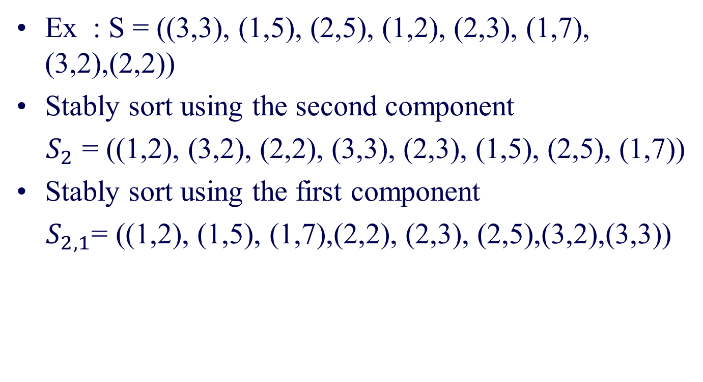
Lexicographic sort
Ex : S = ((3,3), (1,5), (2,5), (1,2), (2,3), (1,7), (3,2),(2,2))
Stably sort using the second component
$S_{2}$ = ((1,2), (3,2), (2,2), (3,3), (2,3), (1,5), (2,5), (1,7))
Stably sort using the first component
$S_{2,1}$= ((1,2), (1,5), (1,7),(2,2), (2,3), (2,5),(3,2),(3,3))

Slide 9
Radix-Sort
Radix-sort is a specialization of lexicographic-sort that uses bucket-sort as the stable sorting algorithm in each dimension
Radix-sort is applicable to tuples where the keys in each dimension i are integers in the range [0, N − 1]
Radix-sort runs in time O(d( n + N))
Algorithm radixSort(S, N)
Input sequence S of d-tuples such
that (0, …, 0) ≤ (x₁, …, x_{d}) and
(x₁, …, x_{d}) ≤ (N − 1, …, N − 1)
for each tuple (x₁, …, x_{d}) in S
Output sequence S sorted in
lexicographic order
for i ← d downto 1
  bucketSort(S, N)

Slide 10
Radix-Sort for Binary Numbers
Consider a sequence of n b-bit integers
x = x_{b − 1} … x₁x₀
We represent each element as a b-tuple of integers in the range [0, 1] and apply radix-sort with N = 2
This application of the radix-sort algorithm runs in O(bn) time
For example, we can sort a sequence of 32-bit integers in linear time
Algorithm binaryRadixSort(S)
Input sequence S of b-bit
integers
Output sequence S sorted
replace each element x
of S with the item (0, x)
for i ← 0 to b − 1
replace the key k of
each item (k, x) of S with bit x_{i} of x
bucketSort(S, 2)

Slide 11
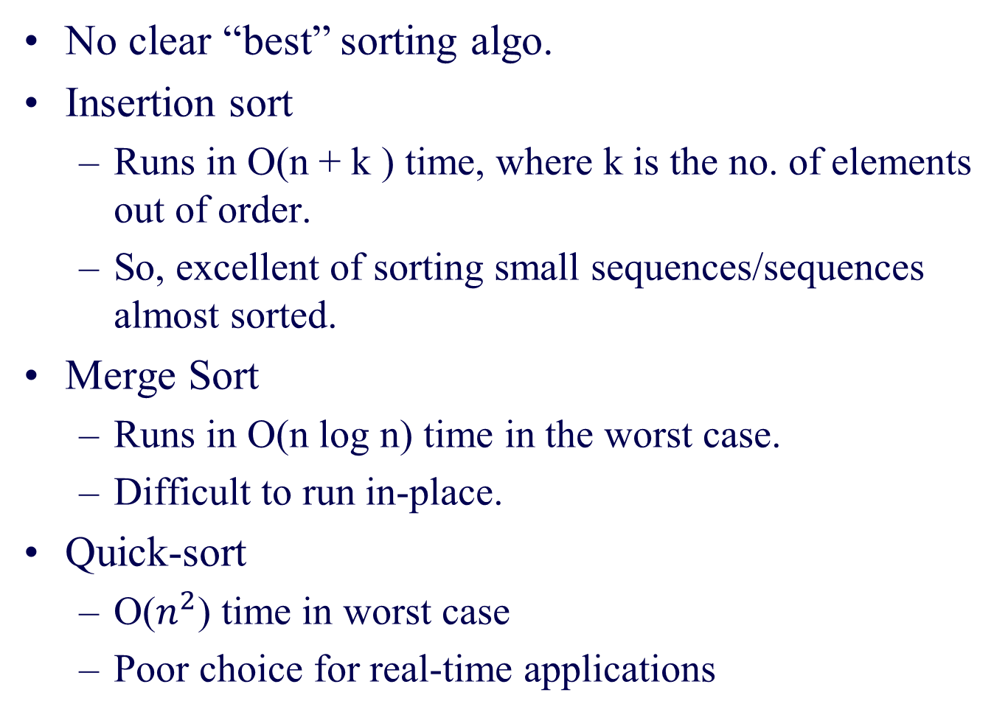
Comparison of sorting algos
No clear “best” sorting algo.
Insertion sort
  Runs in O(n + k ) time, where k is the no. of elements out of order.
  So, excellent of sorting small sequences/sequences almost sorted.
Merge Sort
  Runs in O(n log n) time in the worst case.
  Difficult to run in-place.
Quick-sort
  O($n^{2}$) time in worst case
  Poor choice for real-time applications

Slide 12
Bucket-sort or radix sort
Suitable for sorting by integer keys or d-tuples of integer keys.
Runs in O(d(n + N)) time, where integer keys are in the range [0, N – 1]
If d(n + N) is below n log n, this is faster than even quick sort.

Slide 13
Example
Sorting a sequence of 4-bit integers
1001
0010
1001
1001
0001
0010
1110
1101
0001
0010
1101
1001
0001
0010
1001
0001
1101
0010
1101
1101
1110
0001
1110
1110
1110

Slide 14
Ordered Dictionaries & BST
(Text book Reference 3.1)

Slide 15
Ordered Dictionaries
Keys are assumed to come from a total order.
New operations:
  closestKeyBefore(k)
  closestElemBefore(k)
  closestKeyAfter(k)
  closestElemAfter(k)

Slide 16
Binary Search
Binary search performs operation findElement(k) on a dictionary implemented by means of an array-based sequence, sorted by key
  similar to the high-low game
  at each step, the number of candidate items is halved
  terminates after O(log n) steps
Example: findElement(7)
0
1
3
4
5
7
8
9
11
14
16
18
19
l
m
h
0
1
3
4
5
7
8
9
11
14
16
18
19
l
m
h
0
1
3
4
5
7
8
9
11
14
16
18
19
l
m
h
0
1
3
4
5
7
8
9
11
14
16
18
19
l=m =h

Slide 17
Lookup Table
A lookup table is a dictionary implemented by means of a sorted sequence
  We store the items of the dictionary in an array-based sequence, sorted by key
  We use an external comparator for the keys
Performance:
  findElement takes O(log n) time, using binary search
  insertItem takes O(n) time since in the worst case we have to shift n/2 items to make room for the new item
  removeElement take O(n) time since in the worst case we have to shift n/2 items to compact the items after the removal
The lookup table is effective only for dictionaries of small size or for dictionaries on which searches are the most common operations, while insertions and removals are rarely performed (e.g., credit card authorizations)

Slide 18
Binary Search Tree
A binary search tree is a binary tree storing keys (or key-element pairs) at its internal nodes and satisfying the following property:
  Let u, v, and w be three nodes such that u is in the left subtree of v and w is in the right subtree of v. We have
  key(u) ≤ key(v) ≤ key(w)
External nodes do not store items
An inorder traversal of a binary search trees visits the keys in increasing order
6
2
9
1
4
8

Slide 19
Search
To search for a key k, we trace a downward path starting at the root
The next node visited depends on the outcome of the comparison of k with the key of the current node
If we reach a leaf, the key is not found and we return NO_SUCH_KEY
Example: findElement(4)
Algorithm findElement(k, v)
if T.isExternal (v)
  return NO_SUCH_KEY
  if k < key(v)
  return findElement(k, T.leftChild(v))
  else if k = key(v)
  return element(v)
  else { k > key(v) }
  return findElement(k, T.rightChild(v))
<
6
2
>
9
1
4
=
8

Slide 20
Insertion
<
6
To perform operation insertItem(k, o), we search for key k
Assume k is not already in the tree, and let let w be the leaf reached by the search
We insert k at node w and expand w into an internal node
Example: insert 5
2
>
9
1
4
>
8
w
6
2
9
1
4
8
w
5

Slide 21
Deletion
To perform operation removeElement(k), we search for key k
Assume key k is in the tree, and let let v be the node storing k
If node v has a leaf child w, we remove v and w from the tree with operation removeAboveExternal(w)
Example: remove 4
<
6
2
>
9
1
4
v
8
w
5
6
2
9
1
5
8

Slide 22
Deletion (cont.)
1
v
We consider the case where the key k to be removed is stored at a node v whose children are both internal
  we find the internal node w that follows v in an inorder traversal
  we copy key(w) into node v
  we remove node w and its left child z (which must be a leaf) by means of operation removeAboveExternal(z)
Example: remove 3
3
2
8
6
9
w
5
z
1
v
5
2
8
6
9

Slide 23
Performance
Consider a dictionary with n items implemented by means of a binary search tree of height h
  the space used is O(n)
  methods findElement , insertItem and removeElement take O(h) time
The height h is O(n) in the worst case and O(log n) in the best case

Slide 24
AVL Trees
(Text book Reference 3.2)

Slide 25
AVL Tree Definition
AVL trees are balanced.
An AVL Tree is a binary search tree such that for every internal node v of T, the heights of the children of v can differ by at most 1.
An example of an AVL tree where the heights are shown next to the nodes:

Slide 26
Height of an AVL Tree
n(2)
3
4
n(1)
Fact: The height of an AVL tree storing n keys is O(log n).
Proof: Let us bound n(h): the minimum number of internal nodes of an AVL tree of height h.
We easily see that n(1) = 1 and n(2) = 2
For n > 2, an AVL tree of height h contains the root node, one AVL subtree of height n-1 and another of height n-2.
That is, n(h) = 1 + n(h-1) + n(h-2)
Knowing n(h-1) > n(h-2), we get n(h) > 2n(h-2). So
  n(h) > 2n(h-2), n(h) > 4n(h-4), n(h) > 8n(n-6), … (by induction),
  n(h) > 2^{i}n(h-2i)
Solving the base case we get: n(h) > 2 ^{h/2-1}
Taking logarithms: h < 2log n(h) +2
Thus the height of an AVL tree is O(log n)

Slide 27
Insertion in an AVL Tree
Insertion is as in a binary search tree
Always done by expanding an external node.
Example:
44
44
17
78
17
78
c=z
a=y
32
50
88
32
50
88
48
62
48
62
b=x
54
w
before insertion
after insertion

Slide 28
Trinode Restructuring
let (a,b,c) be an inorder listing of x, y, z
perform the rotations needed to make b the topmost node of the three
(other two cases are symmetrical)
a=z
a=z
case 2: double rotation
(a right rotation about c, then a left rotation about a)
T₀
b=y
T₀
c=y
T₁
c=x
b=x
T₃
T₂
T₃
b=y
T₁
T₂
b=x
a=z
c=x
a=z
c=y
case 1: single rotation
(a left rotation about a)
T₀
T₁
T₂
T₃
T₀
T₁
T₂
T₃

Slide 29
Insertion Example, continued
unbalanced...
T
4
1
44
2
3
x
17
y
62
z
1
2
2
32
50
78
1
1
1
...balanced
48
54
88
T
2
T
T
T
0
1
3

Slide 30
Restructuring (as Single Rotations)
Single Rotations:

Slide 31
Restructuring (as Double Rotations)
double rotations:

Slide 32
Removal in an AVL Tree
Removal begins as in a binary search tree, which means the node removed will become an empty external node. Its parent, w, may cause an imbalance.
Example:
44
44
17
62
17
62
32
50
78
50
78
48
54
88
48
54
88
before deletion of 32
after deletion

Slide 33
Rebalancing after a Removal
Let z be the first unbalanced node encountered while travelling up the tree from w. Also, let y be the child of z with the larger height, and let x be the child of y with the larger height.
We perform restructure(x) to restore balance at z.
As this restructuring may upset the balance of another node higher in the tree, we must continue checking for balance until the root of T is reached
62
a=z
44
44
78
w
17
62
b=y
17
50
88
50
78
c=x
48
54
48
54
88

Slide 34
Running Times for AVL Trees
a single restructure is O(1)
  using a linked-structure binary tree
find is O(log n)
  height of tree is O(log n), no restructures needed
insert is O(log n)
  initial find is O(log n)
  Restructuring up the tree, maintaining heights is O(log n)
remove is O(log n)
  initial find is O(log n)
  Restructuring up the tree, maintaining heights is O(log n)

Slide 35
This presentation & the practice problems will be available in the course page.
http://discovery.bits-pilani.ac.in/discipline/csis/vimal/course%2007-08%20First/DSA_Offcampus/DSA.htm
Questions ?

